Slide 1
Department of Information Technology
A.P. Shah Institute of Technology G.B.Road,Kasarvadavli, Thane(W), Mumbai-400615
UNIVERSITY OF MUMBAI
Academic Year 2019-2020

Slide 2
A Project Report on
DEXTER- The College FAQ Chatbot
Submitted in partial fulfillment of the degree of Bachelor of Engineering(Sem-7)
in
INFORMATION TECHNOLOGY
By
Ajinkya Huddar(15104047) Chaitaniya Bysani(16104045) Chintan Suchak(16104069)
Under the Guidance of Dr. Uttam D. Kolekar

Slide 3
1.Project Conception and Initiation

Slide 4
1.1 Abstract
Chatbot can be described as software that can chat with people using artificial intelligence. These software are used to perform tasks such as quickly responding to users, informing them, helping to purchase products and providing better service to customers..
In college’s, especially during the time of admission , reception gets crowded and
people have to wait to get their queries solved.
Al though every college has its own website, not everybody is able to find the answer to their query.
This chatbot will be embedded on the college website and will be able to answer any college-related query easily.
Chatbot will be able to answer multiple persons at the same time, people don’t have to
visit the college to get their query solved and it will be available 24/7.

Slide 5
1.2 Objectives
To reduces the work stress of reception.
To make navigation through the college website easier for students
To provide answers regarding “What do I do know?” questions.
To improve Query Handling System since chatbot is available 24 x 7.
To help new student get familiar with the new Environment.
To help students give a brief idea about college so that they can decide whether they should visit the college or not.

Slide 6
1.3 Literature Review
In literature[1] - The authors have described about how the number of individuals looking for well being data from the web increments drastically.
A few elements impact individuals to utilize the web for scanning for well being data. Confided in restorative data, for example , infections, side effects, and treatment is important for individuals to deal with some broad sickness or being utilized as a bit of choice help data before visiting a specialist.
In this work , the therapeutic guide framework called ”MedBot” was created by utilizing Dialog flow controlled by Google’s machine learning.

Slide 7
1.3 Literature Review
In literature[2]- The author describes about a chatbot whose exploration displays a
strategy for creating chatbots to serve their clients.
A profound learning based conversational man-made brain power procedure was utilized as apparatuses for learning discussion among machine and client.
Additionally, the means required are the procedure utilized related to the convolution
neural system strategy by utilizing Tensorflow preparing to improve the precision of these chatbots.
This article has not used cloud for their databases to rage which takes a little longer to fetch data . Hence the speed off etching is slow.

Slide 8
1.3 Literature Review
In literature[3]- The author describes how the quantity of web-based business clients has expanded quickly. In 2017,the number of computerized purchasers was over 1.66 billion individuals world wide up from 1.32 billion in 2014.
The paper also gives information about on line shops which regularly require
administrations, for example, live talk for clients support.
As the quantity of clients has expanded by about 10 percent every year, the interest for the client the administration additionally increments, authors came up with an idea of converting online client support methodologies to a chatbot to reply to clients’ inquiries consequently.

Slide 9
1.4 Problem Definition
The main reason behind choosing this topic as the project was that many students were facing issues regarding the updates of revaluation examinations or results, about any important notice and events going on in the college.
It becomes really difficult for students who stay far away from the college and they
just have to come to college for inquiry purpose.
Even reception becomes complete chaos during the time of admission, many students and parents visit the college reception to get their queries solved.
The receptionist will only be able to handle 2 to 3 person at a time and others will have to wait for their turn. This will also cause tiredness for receptionist.
To overcome this problems, we are making the graphical user interface inquiry
chatbot which gives 24*7 updates regarding any ongoing events or notice.

Slide 10
1.5 Scope
As per the predicitons, that seems to appear in the coming five year’s, there is a high possibility that about 80% of the communications will be done through Chatbots.
Chatbot messengers will be in charge of faciliting business to consumer interaction, which will be in a flawless manner.
Now this gives the explanation on why outlets stores, online retailer promote the
installation of text-related chatbots and voice-assisted bots for verifying orders and making the delivery and purchase of orders.

Slide 11
1.6 Technology stack
Rasa Stack
RNN (Recurrent Neural Networks)
LSTM (Long Short Term Memory)
Artificial Intelligence

Slide 12
1.7 Benefits for Environment & Society
Accessible anytime
Handling Capacity
Customer Satisfaction
Flexible attribute
Cost Effective
Personal Assistant
Alternate sales channel

Slide 13
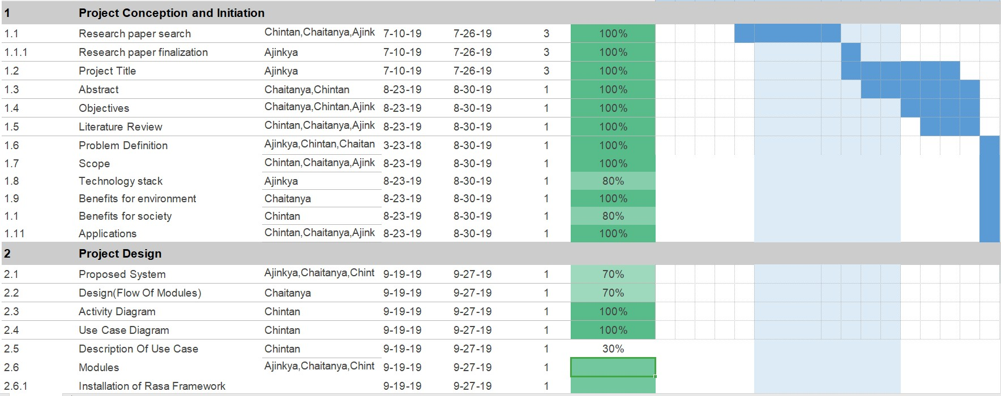
Project Timeline

Slide 14
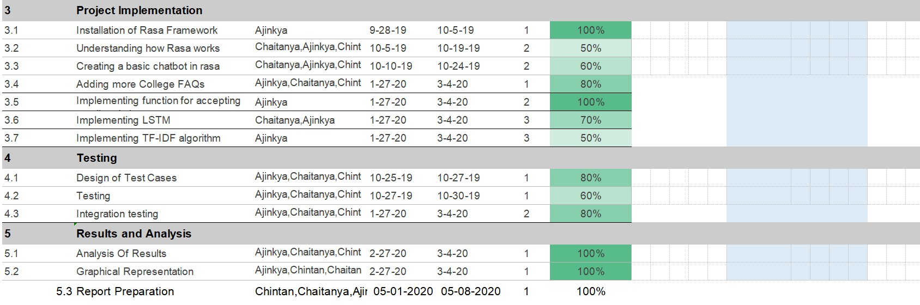
Project Timeline

Slide 15
2. Project Design

Slide 16
2.1 Proposed System
This chatbot will provide answers to all the questions whose answers are predefined in
the database.
The database will be created in the cloud so that whenever we want to make any modifications in our database, we can do it without any difficulty.
The chatbot will have Artificial Intelligence which will allow it to produce answers for
even those question whose answers are not defined.
The chatbot will be Generative model because of which it will be able to generate new responses from scratch.
It will be done by using RNN(Recurrent Neural Network) and LSTM (Long Short Term Memory). We will use Rasa Stack for the development of our chatbot.
Rasa Stack is an open source development tool which provides a platform for
developing a chatbot.

Slide 17
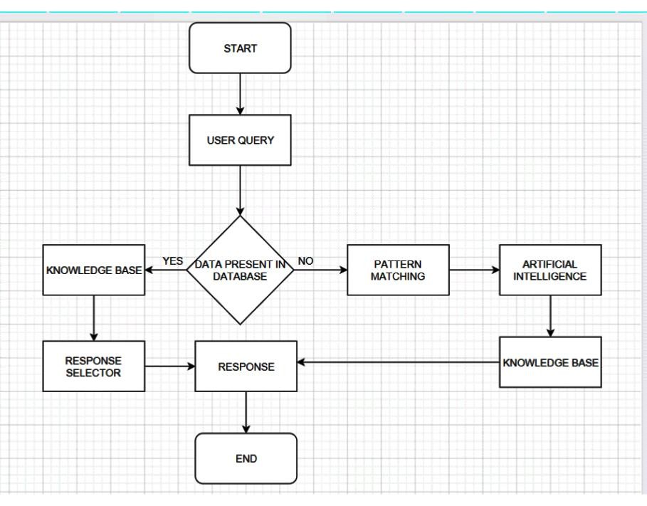
2.2 Design(Flow Of Modules)

Slide 18
2.3 Description Of Use Case
User will first type their query to chatbot, Chatbot will check if the answer to that query is available in database or not.
If the answer to the query is available, it will provide respective answer, If the answer is not present, it will perform pattern matching and artificial intelligence to build an answer and will send an alert to admin to add this query to the database.
After that it will provide the response and ask if the user has any more query If
not the chatbot closes.

Slide 19
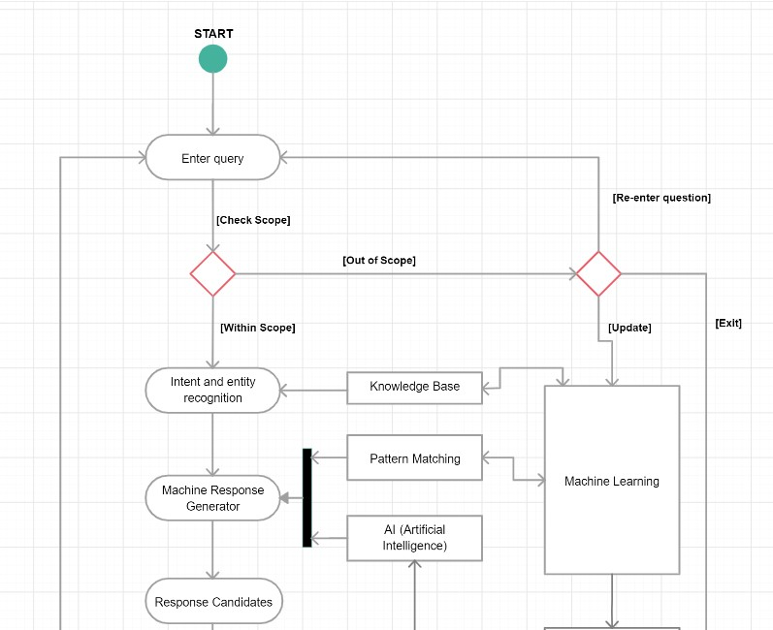
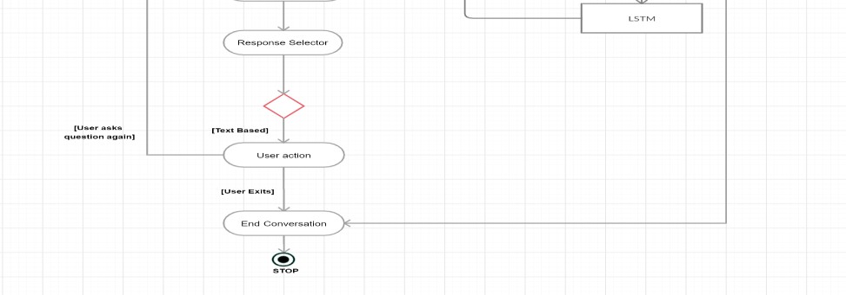
2.4 Activity diagram

Slide 20
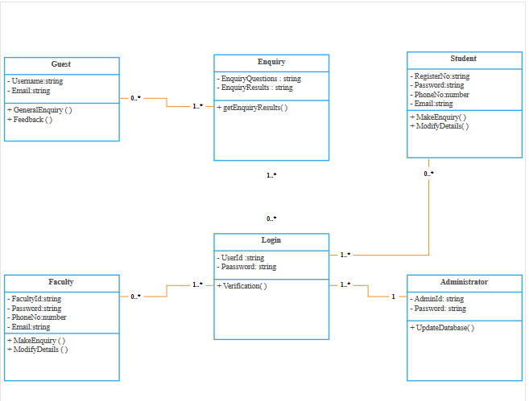
2.5 Class Diagram

Slide 21
2.6 Installation of Rasa Framework
Step-by-step Installation Guide
Install the Python development environment
Create a virtual environment (strongly recommended)
Install Rasa and Rasa X (Using given Command on terminal) After Successfully Installing Rasa, Download following Dependencies
NLU Pipeline Dependencies
SpaCy Dependencies

Slide 22
Understanding How Rasa works
AI assistants have to fulfill two tasks: understanding the user and giving the correct responses. The Rasa Stack tackles these tasks with the natural language understanding component Rasa NLU and the dialogue management component Rasa Core.
Rasa NLU is responsible for natural language understanding of the chatbot. Its main purpose is, given an input sentence, predict an intent of that sentence and extract useful entities from it.
Rasa Core, It takes structured input in the form of intents and entities and chooses which action the bot should take using a probabilistic model (to be more specific, it uses LSTM neural network implemented in Keras).

Slide 23
Creating a basic Chatbot in Rasa
Extracting User Intent from a Message
The three files we will be using are highlighted above.
data/nlu-data.md : This is the file where you will save your training data for extracting the user
intent.
nlu-config.yml : This file lets us create a text processing pipeline in Rasa. Luckily for us, Rasa comes with two default settings based on the amount of training data we have: “spacy-sklearn” pipeline if you have less than 1000 training examples “tensorflow_embedding” if you have a large amount of data
domain.md : It specifies the intents, entities, slots, and actions your bot should know about.
Optionally, it can also include responses for the things your bot can say.

Slide 24
Creating a basic Chatbot in Rasa
Training the NLU classifier
Predicting the Intent
Making Interactive Conversations
Designing the conversational flow
Defining the Domain
Setting Policies
Training the Conversation Model

Slide 25
Future Goals
Voice can be integrated in custom Rasa Chatbot
We can include various languages so that we become easy for the user to communicate
It can be futhur deployed into an android / ios application.

Slide 26
2.7 References
Nudtaporn Rosruen and Taweesak Samanchuen “Chatbot Utilization for Medical Consultant System”, The 2018 Technology Innovation Management and Engineering Science International Conference(TIMES-iCON2018)
SathitPrasomphan, “Improvement of Chatbot in Trading System for SMEs by
Using Deep Neural Network”,2019IEEE4th International Conference on Cloud
Computing and Big Data Analytics.
Panitan Muangkammuen,Narong Intiruk, Kanda Runapongsa Saikaew,
“Automated Thai-FAQ Chatbot using RNN-LSTM”

Slide 27
Thank You

